Slide 1
Deep Neural Network
Dr. Monali Mavani

Slide 2

Deep Neural Network
Disclaimer and Acknowledgement
The content for these slides has been obtained from books and various other source on the Internet
I here by acknowledge all the contributors for their material and inputs.
I have provided source information wherever necessary
I have added and modified the content to suit the requirements of the course

Slide 3
Session Agenda
Back Propagation

Slide 4
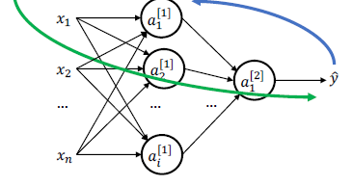


Training: Go Forwards, then Backwards…
Step 3: Calculate partial derivatives (using Backpropagation)
Step 1: Calculate 𝒚 ̂ using
computation graph.
Step 2: Determine the cost.
Step 4: Update each parameter

Slide 5
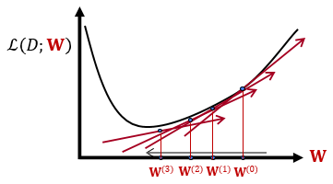
Training Neural Networks: optimizing parameters
We are given an architecture though its weights 𝐖.
Also given a training data 𝐷 = {(𝐱_{𝑖}, 𝑦_{i})}
We are given a loss function ℒ(𝐷; 𝐖)
We can use gradient descent to minimizes the loss.
At each step, the weight vector is modified in the direction that produces the steepest descent along the error surface.

Slide 6
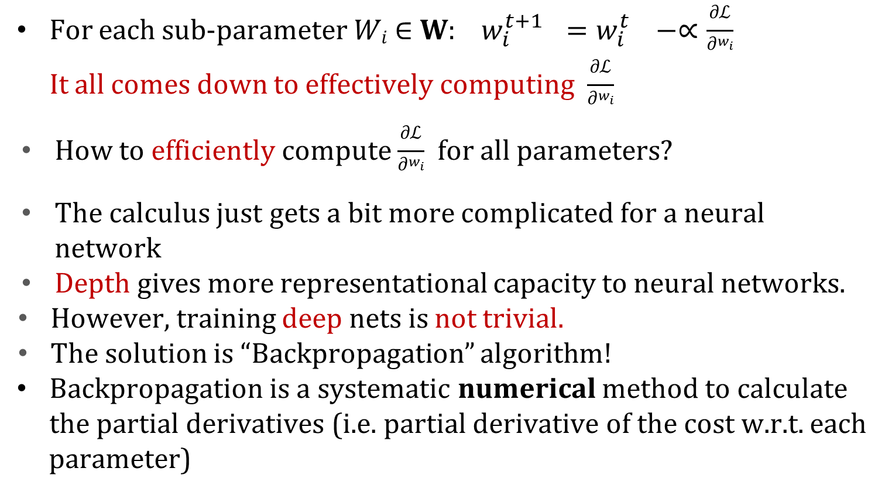
Algorithm for Gradient Computation – Backpropagation
For each sub-parameter 𝑊_{𝑖} ∈ 𝐖: $w_{i}^{t+1 }=w_{i}^{t }−∝\frac{\text{∂}\text{ℒ}}{\text{∂}w_{i}}$ It all comes down to effectively computing $\frac{\text{∂}\text{ℒ}}{\text{∂}w_{i}}$
How to efficiently compute $\frac{\text{∂}\text{ℒ}}{\text{∂}w_{i}}$ for all parameters?
The calculus just gets a bit more complicated for a neural network
Depth gives more representational capacity to neural networks.
However, training deep nets is not trivial.
The solution is “Backpropagation” algorithm!
Backpropagation is a systematic numerical method to calculate the partial derivatives (i.e. partial derivative of the cost w.r.t. each
parameter)
Rumelhart, Hinton, Williams, “Learning Representations by Back-Propagating Errors”, 1986

Slide 7
Key Intuitions Required for Backpropagation
Gradient Descent
Change the weights 𝐖 in the direction of gradient to minimize the error function.
Chain Rule
Use the chain rule to calculate the weights of the intermediate weights
Dynamic Programming (Memorization)
Parameter gradients depend on the gradients of the earlier layers!
So, when computing gradients at each layer, we can reuse gradients computed for higher layers for lower layers (i.e., memorization).

Slide 8

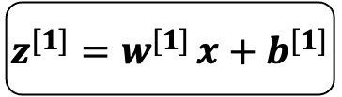







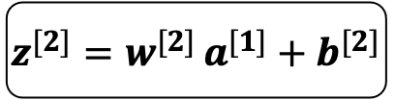
The Computation Graph of A Neural Network
we can represent any neural network in terms of a computation graph
The loss function can be computed by moving from left to right
$$b^{[2]}$$
$$b^{[1]}$$
$$W^{[2]}$$
$$x$$
$$z^{[1]}=w^{[1] }x+b^{[1]}$$
$$a^{[1]}=σ(z^{[1]})$$
$$z^{[2]}=w^{[2] }a^{[1]}+b^{[2]}$$
$$a^{[2]}=σ(z^{[2]})$$
$$𝓛(a^{[2]},y)$$
$$W^{[1]}$$
The corresponding computation graph
Cross entropy cost function:
$$Cost\left(ŷ,y\right)=−y∗logŷ−\left(1−y\right)log\left(1−ŷ\right)$$

Slide 9



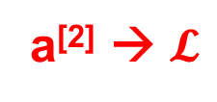

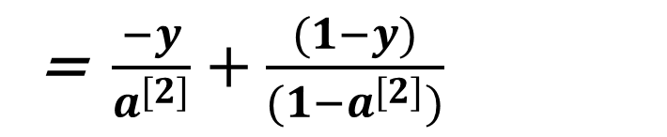


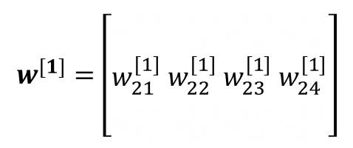


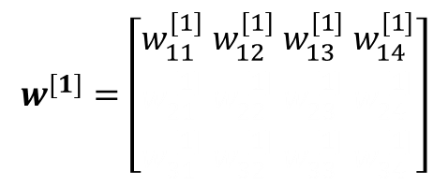


Backward Propagation
$$b^{[2]}$$
$ŷ$ = $a^{[2]}$
$$b^{[1]}$$
$$W^{[2]}$$
$$x$$
$$z^{[1]}=w^{[1] }x+b^{[1]}$$
$$a^{[1]}=σ(z^{[1]})$$
$$z^{[2]}=w^{[2] }a^{[1]}+b^{[2]}$$
$$a^{[2]}=σ(z^{[2]})$$
$$𝓛(a^{[2]},y)$$
$$W^{[1]}$$
a^{[2]} → $𝓛$
$$\frac{∂𝓛}{∂a^{[2]}}= \frac{∂}{∂a[2]}\left(−ylog\left(a[2]\right)−\left(1−y\right)log\left(1−a[2]\right)\right)$$
= $\frac{−y}{a^{[2]}}+\frac{(1−y)}{(1−a^{[2]})}$

Slide 10
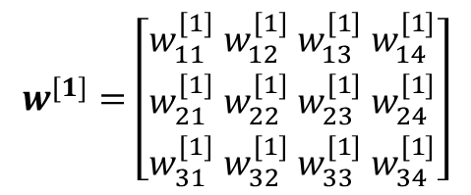
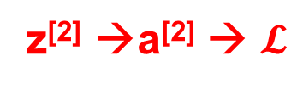
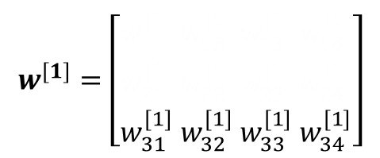
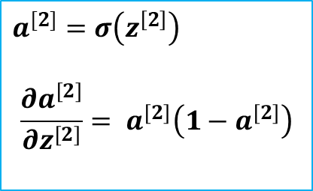
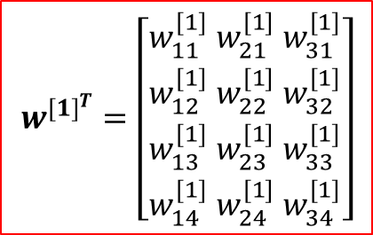

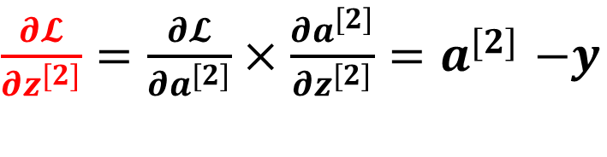
Backward Propagation
$$b^{[2]}$$
$$b^{[1]}$$
$$W^{[2]}$$
$$x$$
$$z^{[1]}=w^{[1] }x+b^{[1]}$$
$$a^{[1]}=σ(z^{[1]})$$
$$z^{[2]}=w^{[2] }a^{[1]}+b^{[2]}$$
$$a^{[2]}=σ(z^{[2]})$$
$$𝓛(a^{[2]},y)$$
$$W^{[1]}$$
z^{[2]} →a^{[2]} → $𝓛$
$$a^{[2]}=σ\left(z^{\left[2\right]}\right)$$
$$\frac{∂a^{[2]}}{∂z^{[2]}}= a^{[2]}\left(1−a^{[2]}\right)$$
$\frac{∂𝓛}{∂z^{[2]}}=\frac{∂𝓛}{∂a^{[2]}}×\frac{∂a^{[2]}}{∂z^{[2]}}$ ${=a}^{[2]}−y$
Error term = δ^{[2]}

Slide 11
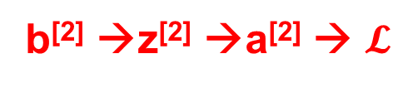
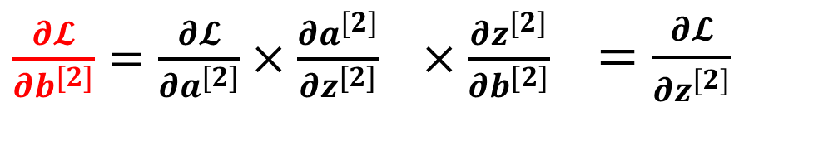


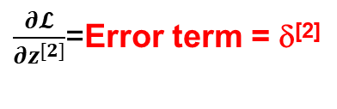
Backward Propagation
$$b^{[2]}$$
$$b^{[1]}$$
$$W^{[2]}$$
$$x$$
$$z^{[1]}=w^{[1] }x+b^{[1]}$$
$$a^{[1]}=σ(z^{[1]})$$
$$z^{[2]}=w^{[2] }a^{[1]}+b^{[2]}$$
$$a^{[2]}=σ(z^{[2]})$$
$$𝓛(a^{[2]},y)$$
$$W^{[1]}$$
b^{[2]} →z^{[2]} →a^{[2]} → $𝓛$
$\frac{∂𝓛}{∂b^{[2]}}=\frac{∂𝓛}{∂a^{[2]}}×\frac{∂a^{[2]}}{∂z^{[2]}} ×\frac{∂z^{[2]}}{∂b^{[2]}}$ $=\frac{∂𝓛}{∂z^{[2]}}$
$\frac{∂𝓛}{∂z^{[2]}}$=Error term = δ^{[2]}
1

Slide 12


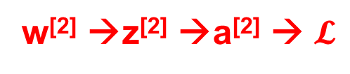

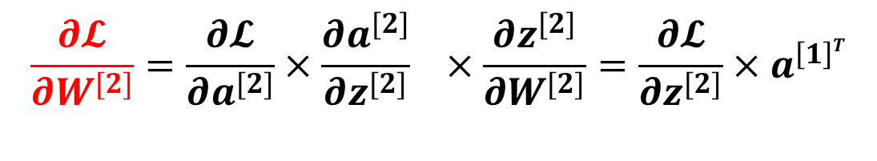

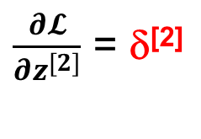
Backward Propagation
$$b^{[2]}$$
$$b^{[1]}$$
$$W^{[2]}$$
$$x$$
$$z^{[1]}=w^{[1] }x+b^{[1]}$$
$$a^{[1]}=σ(z^{[1]})$$
$$z^{[2]}=w^{[2] }a^{[1]}+b^{[2]}$$
$$a^{[2]}=σ(z^{[2]})$$
$$𝓛(a^{[2]},y)$$
$$W^{[1]}$$
w^{[2]} →z^{[2]} →a^{[2]} → $𝓛$
$$\frac{∂𝓛}{∂W^{[2]}}=\frac{∂𝓛}{∂a^{[2]}}×\frac{∂a^{[2]}}{∂z^{[2]}} ×\frac{∂z^{[2]}}{∂W^{[2]}}=\frac{∂𝓛}{∂z^{[2]}}{×a}^{\left[1\right]T}$$
Dimension of dz^{[2]} is (n^{[2]},1)
Dimension of a^{[1]} is (n^{[1]},1)
Hence transpose of a^{[1]}
Dimension of dW^{[2]} is (n^{[2]}, n^{[1]})
$\frac{∂𝓛}{∂z^{[2]}}$ = δ^{[2]}

Slide 13

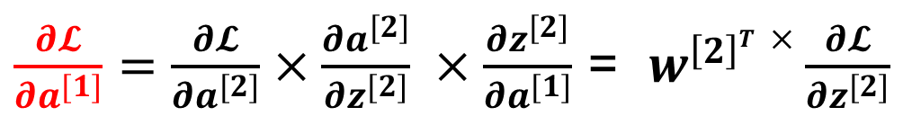
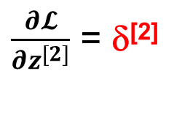
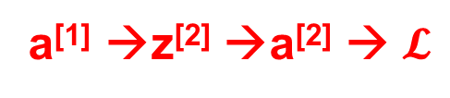

Backward Propagation
$$b^{[1]}$$
$$W^{[2]}$$
$$x$$
$$z^{[1]}=w^{[1] }x+b^{[1]}$$
$$a^{[1]}=σ(z^{[1]})$$
$$z^{[2]}=w^{[2] }a^{[1]}+b^{[2]}$$
$$a^{[2]}=σ(z^{[2]})$$
$$𝓛(a^{[2]},y)$$
$$W^{[1]}$$
$$b^{[2]}$$
a^{[1]} →z^{[2]} →a^{[2]} → $𝓛$
$\frac{∂𝓛}{∂a^{[1]}}=\frac{∂𝓛}{∂a^{[2]}}×\frac{∂a^{[2]}}{∂z^{[2]}} ×\frac{∂z^{[2]}}{∂a^{[1]}}$ = $w^{\left[2\right]T}×\frac{∂𝓛}{∂z^{[2]}}$
$\frac{∂𝓛}{∂z^{[2]}}$ = δ^{[2]}
Dimension of dz^{[2]} is (n^{[2]},1)
Dimension of W^{[2]} is (n^{[2]}, n^{[1]})
Dimension of da^{[1]} is (n^{[1]},1)

Slide 14

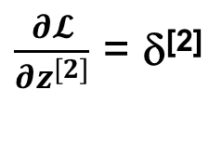
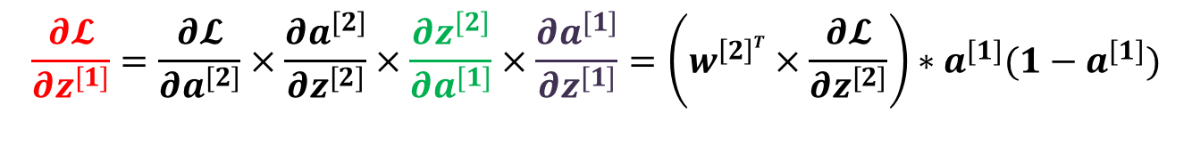



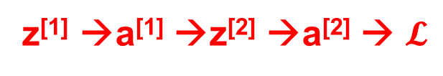
Backward Propagation
Dimension of dz^{[2]} is (n^{[2]},1)
Dimension of W^{[2]} is (n^{[2]}, n^{[1]})
Dimension of da^{[1]} is (n^{[1]},1)
Dimension of dz^{[1]} is (n^{[1]},1)
$$b^{[2]}$$
$$b^{[1]}$$
$$W^{[2]}$$
$$x$$
$$z^{[1]}=w^{[1] }x+b^{[1]}$$
$$a^{[1]}=σ(z^{[1]})$$
$$z^{[2]}=w^{[2] }a^{[1]}+b^{[2]}$$
$$a^{[2]}=σ(z^{[2]})$$
$$𝓛(a^{[2]},y)$$
$$W^{[1]}$$
z^{[1]} →a^{[1]} →z^{[2]} →a^{[2]} → $𝓛$
Element-wise product
$$\frac{∂𝓛}{∂z^{[1]}}=\frac{∂𝓛}{∂a^{[2]}}×\frac{∂a^{[2]}}{∂z^{[2]}}×\frac{∂z^{[2]}}{∂a^{[1]}}×\frac{∂a^{[1]}}{∂z^{[1]}}=\left(w^{\left[2\right]T}×\frac{∂𝓛}{∂z^{[2]}}\right)∗a^{[1]}(1−a^{[1]})$$
δ^{[1]}
$$a^{[1]}=σ\left(z^{\left[1\right]}\right)$$
$$\frac{∂a^{[1]}}{∂z^{[1]}}= a^{[1]}\left(1−a^{[1]}\right)$$
$\frac{∂𝓛}{∂z^{[2]}}$ = δ^{[2]}

Slide 15


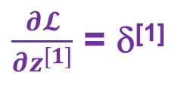
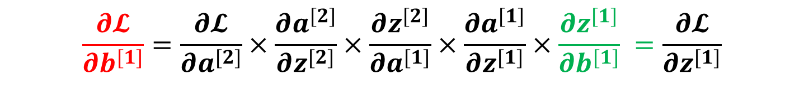

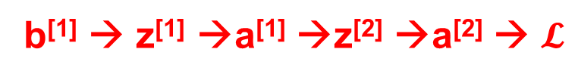
Backward Propagation
$$b^{[2]}$$
$$b^{[1]}$$
$$W^{[2]}$$
$$x$$
$$z^{[1]}=w^{[1] }x+b^{[1]}$$
$$a^{[1]}=σ(z^{[1]})$$
$$z^{[2]}=w^{[2] }a^{[1]}+b^{[2]}$$
$$a^{[2]}=σ(z^{[2]})$$
$$𝓛(a^{[2]},y)$$
$$W^{[1]}$$
b^{[1]} → z^{[1]} →a^{[1]} →z^{[2]} →a^{[2]} → $𝓛$
$$\frac{∂𝓛}{∂b^{[1]}}=\frac{∂𝓛}{∂a^{[2]}}×\frac{∂a^{[2]}}{∂z^{[2]}}×\frac{∂z^{[2]}}{∂a^{[1]}}×\frac{∂a^{[1]}}{∂z^{[1]}}×\frac{∂z^{[1]}}{∂b^{[1]}} =\frac{∂𝓛}{∂z^{[1]}}$$
$\frac{∂𝓛}{∂z^{[1]}}$ = δ^{[1]}
$$1$$

Slide 16




Backward Propagation
$$b^{[2]}$$
$$b^{[1]}$$
$$W^{[2]}$$
$$x$$
$$z^{[1]}=w^{[1] }x+b^{[1]}$$
$$a^{[1]}=σ(z^{[1]})$$
$$z^{[2]}=w^{[2] }a^{[1]}+b^{[2]}$$
$$a^{[2]}=σ(z^{[2]})$$
$$𝓛(a^{[2]},y)$$
$$W^{[1]}$$
W^{[1]}→ z^{[1]} →a^{[1]} →z^{[2]} →a^{[2]} → $𝓛$
$$\frac{∂𝓛}{∂w^{[1]}}=\frac{∂𝓛}{∂a^{[2]}}×\frac{∂a^{[2]}}{∂z^{[2]}}×\frac{∂z^{[2]}}{∂a^{[1]}}×\frac{∂a^{[1]}}{∂z^{[1]}}×\frac{∂z^{[1]}}{∂w^{[1]}} =\frac{∂𝓛}{∂z^{[1]}}{ x}^{T}$$
x

Slide 17

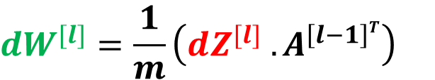

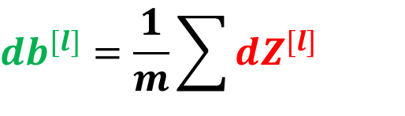




Equations for layer l
One training example
For all training example
Input da^{[l]}
Output da^{[l-1],} dw^{[l]} , db^{[l]}
$$dZ^{[l]}=w^{\left(l+1\right)T}.\frac{∂𝓛}{∂Z^{\left[l+1\right]}}∗g^{[l]`}\left(Z^{[l]}\right)$$
$$dz^{[l]}=w^{\left(l+1\right)T}.\frac{∂𝓛}{∂z^{[l+1]}}∗g^{[l]`}\left(z^{[l]}\right)$$
$$db^{[l]}=\frac{1}{m}\sum{dZ^{[l]}}$$
$$db^{[l]}=dz^{[l]}=δ^{\left(l\right)}$$
$$dW^{[l]}=\frac{1}{m}\left(dZ^{[l]}{ . A}^{\left[l−1\right]T}\right)$$
$$dW^{[l]}=dz\left[l\right]{ . a}^{\left[l−1\right]}$$
$$da^{[l−1]}=W^{\left[l\right]T }dz^{[l]}$$
$$dA^{[l−1]}={ W}^{\left[l\right]T }dZ^{[l]}$$

Slide 18
Backpropagation: The Key Algorithm
Purpose
Backpropagation efficiently computes gradients of the loss w.r.t. all parameters by applying the chain rule backward through the network.
Key insight: Use chain rule recursively Notation: Define error signal for layer l:
_{δ}(l) ₌
∂J
_{∈ R}B×n_{Æ}
_{∂Z}(l)
(39)
Two main steps:
1
Backpropagate error signals: δ^{(L)} → δ^{(L—1)} → · · · → δ⁽¹⁾
2
Compute parameter gradients using error signals
Deep Learning

Slide 19
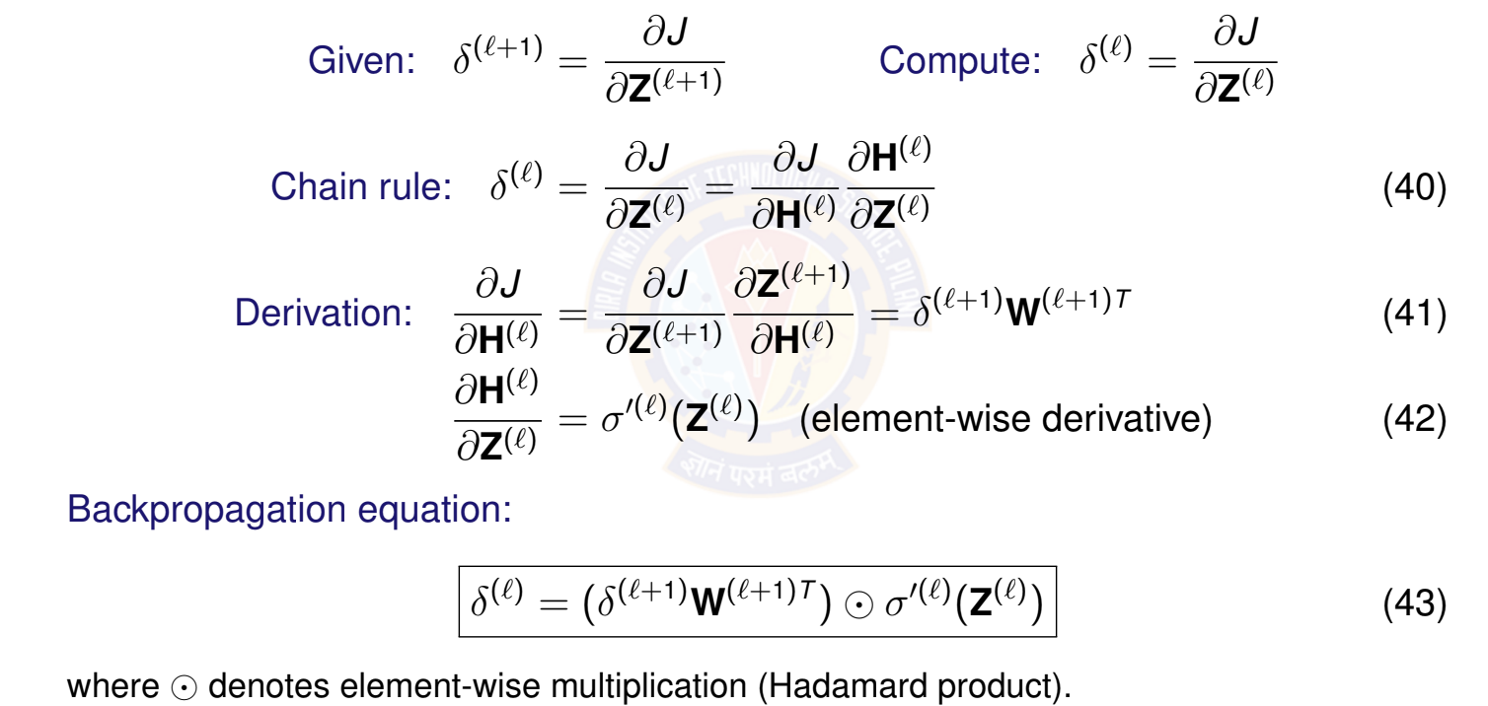
Backpropagating Error Signals
Deep Learning
34 / 67

Slide 20
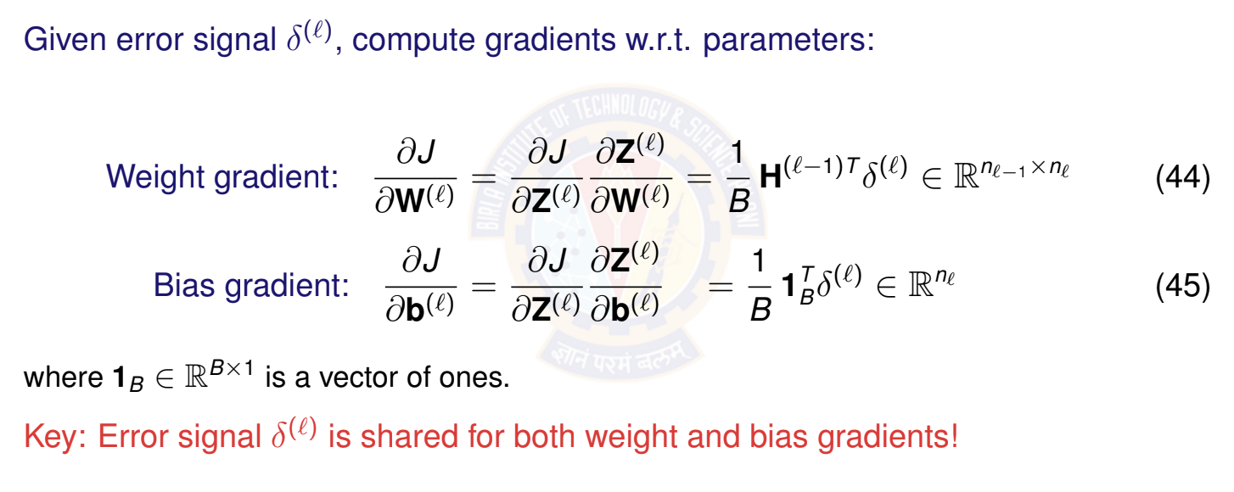



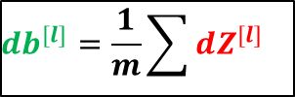
Computing Parameter Gradients
$$db^{[l]}=\frac{1}{m}\sum{dZ^{[l]}}$$
$$dW^{[l]}=\frac{1}{m}\left(dZ^{[l]}{ . A}^{\left[l−1\right]T}\right)$$
$$z^{[1]}=w^{[1] }x+b^{[1]}$$
Deep Learning

Slide 21
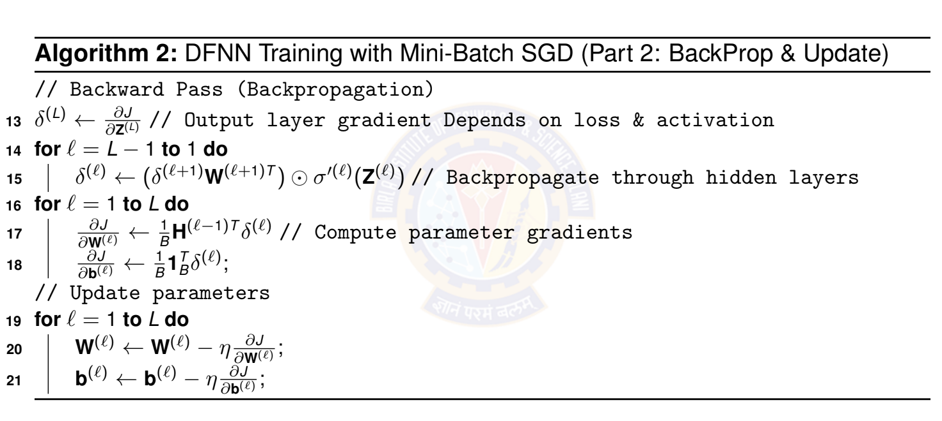
Training Algorithm: Mini-Batch SGD
Deep Learning

Slide 22
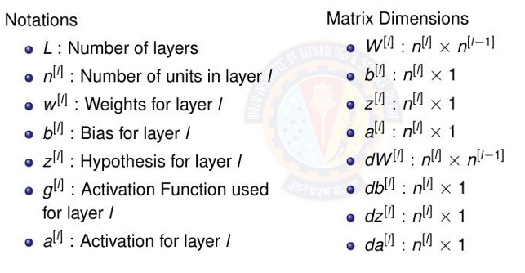
Scaling up for L layers and all training examples in NN

Slide 23
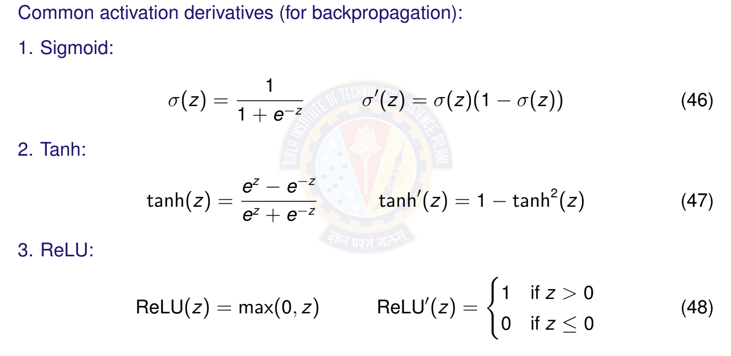
Activation Function Derivatives
Deep Learning

Slide 24
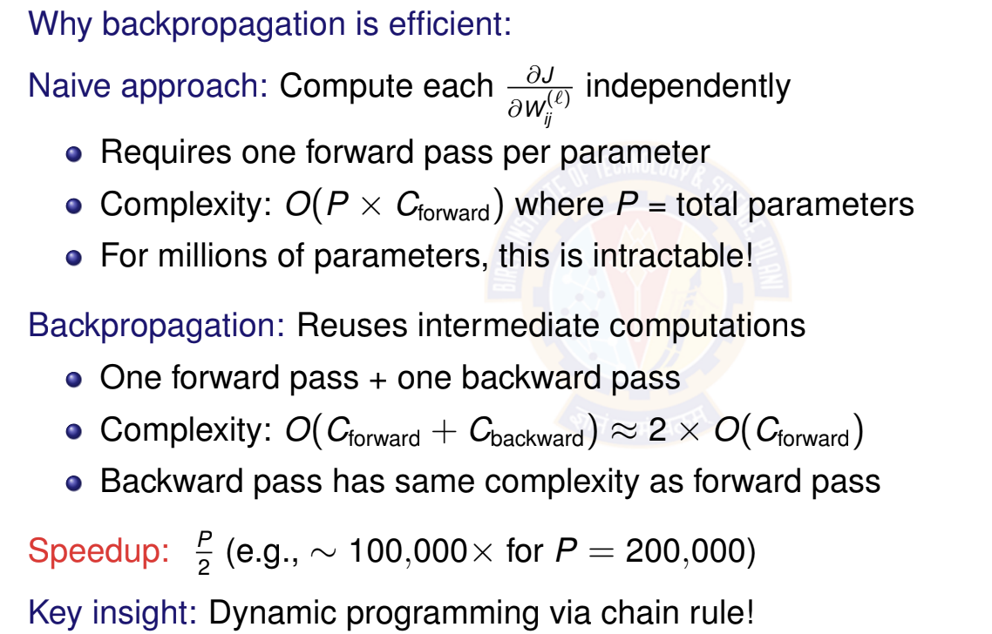
Computational Efficiency of Backpropagation
Deep Learning

Slide 25
Parameter Update Step
After computing gradients, update all parameters:
For each layer l = 1, . . . , L: (Vector form for single example)
_{W}(l) _{← W}(l) _{− ηh}(l—1)T _{δ}(l)
_{b}(l) _{← b}(l) _{− ηδ}(l)
(49)
(50)
where η > 0 is the learning rate.
This moves parameters in the direction that reduces the loss!
Deep Learning

Slide 26
Demo
https://playground.tensorflow.org/

Slide 27
Optional

Slide 28
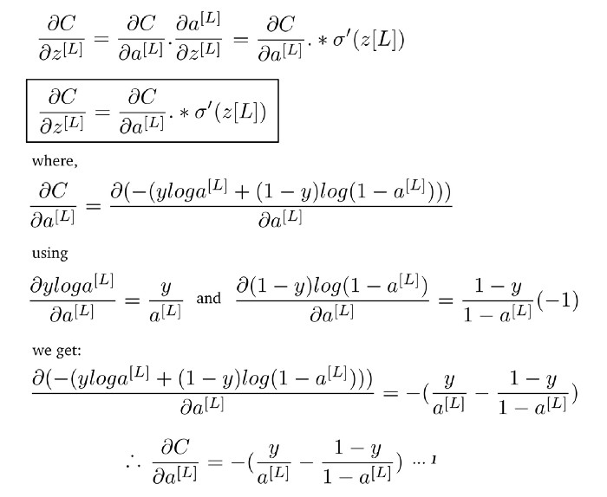
Derivative of cost function w.r.t final layer linear function

Slide 29
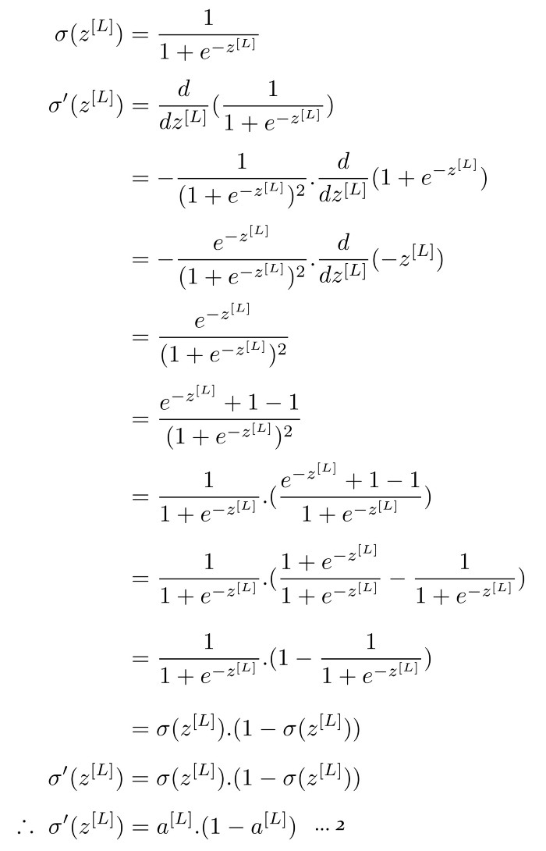
Derivative of cost function w.r.t final layer linear function (Derivative of sigmoid activation function)

Slide 30
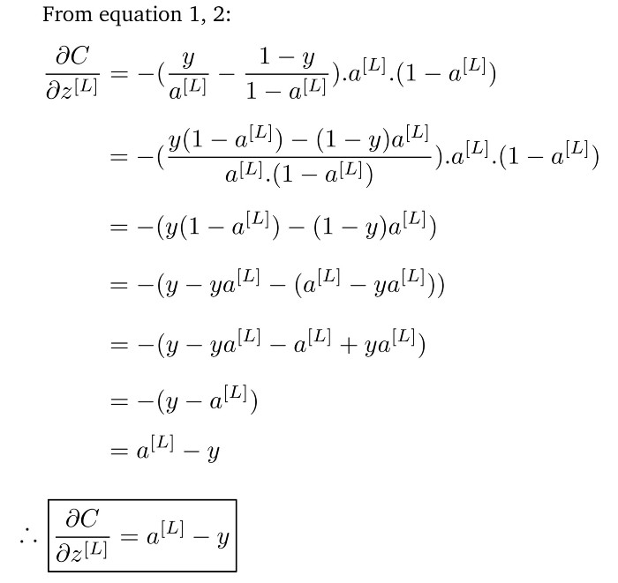
Derivative of cost function w.r.t final layer linear function

Slide 31
Thank You All !

